Slide 1
Sikhism
A Guide to the 5th Largest Religion in the World
Notes:
Please explain about turban, why we wear turban, it was a challenge to Moughals, that the Sikhs wear their crown.
say we welcome all, free food, concept of Seva, creates equality, sitting down and sharing of food brings humility.
We live by American rules, equality, believe in self defense, help others. Love to eat, sing, dance and enjoy life. Punjabi music is the most followed music in whole India. There are Bhangra nights in clubs, in gyms there is bhangra workouts. Just some fun stuff.

Slide 2
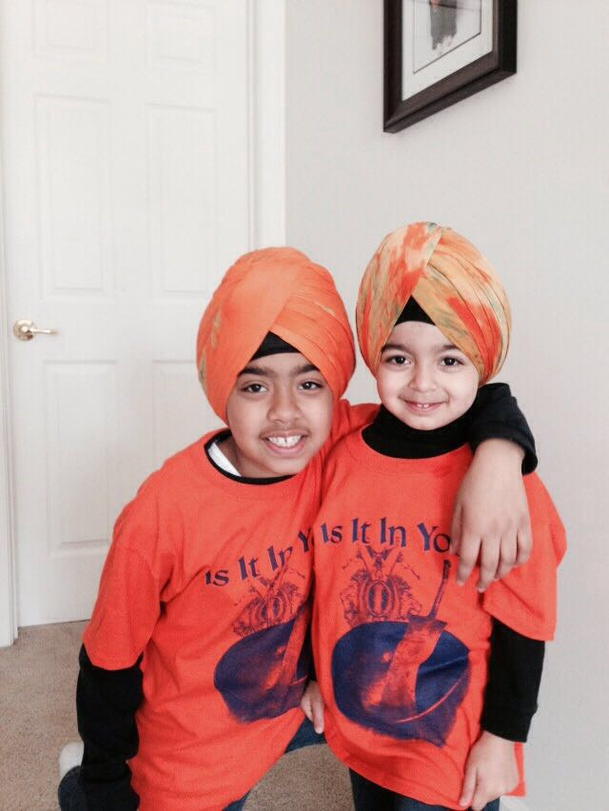
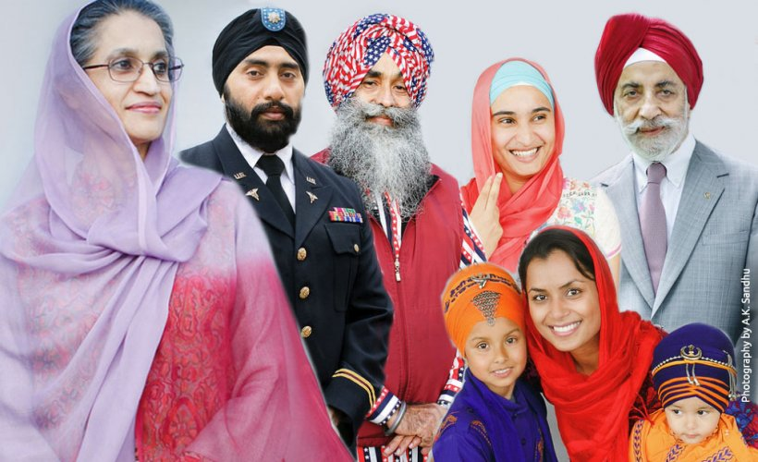
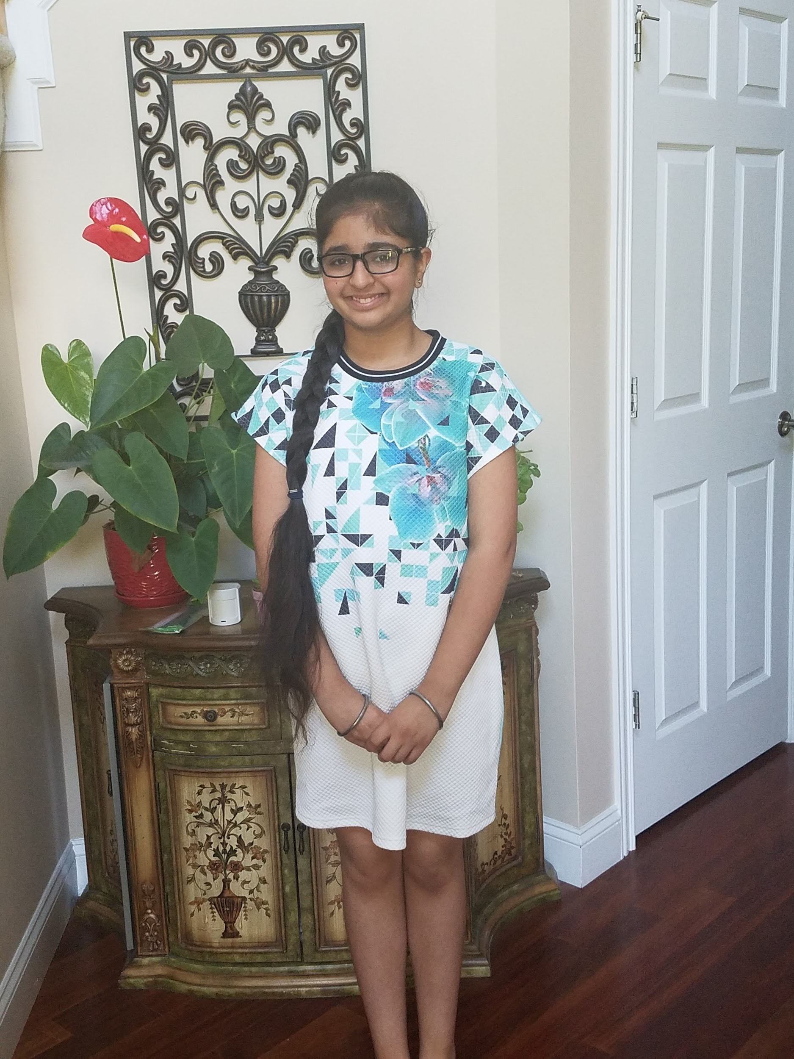
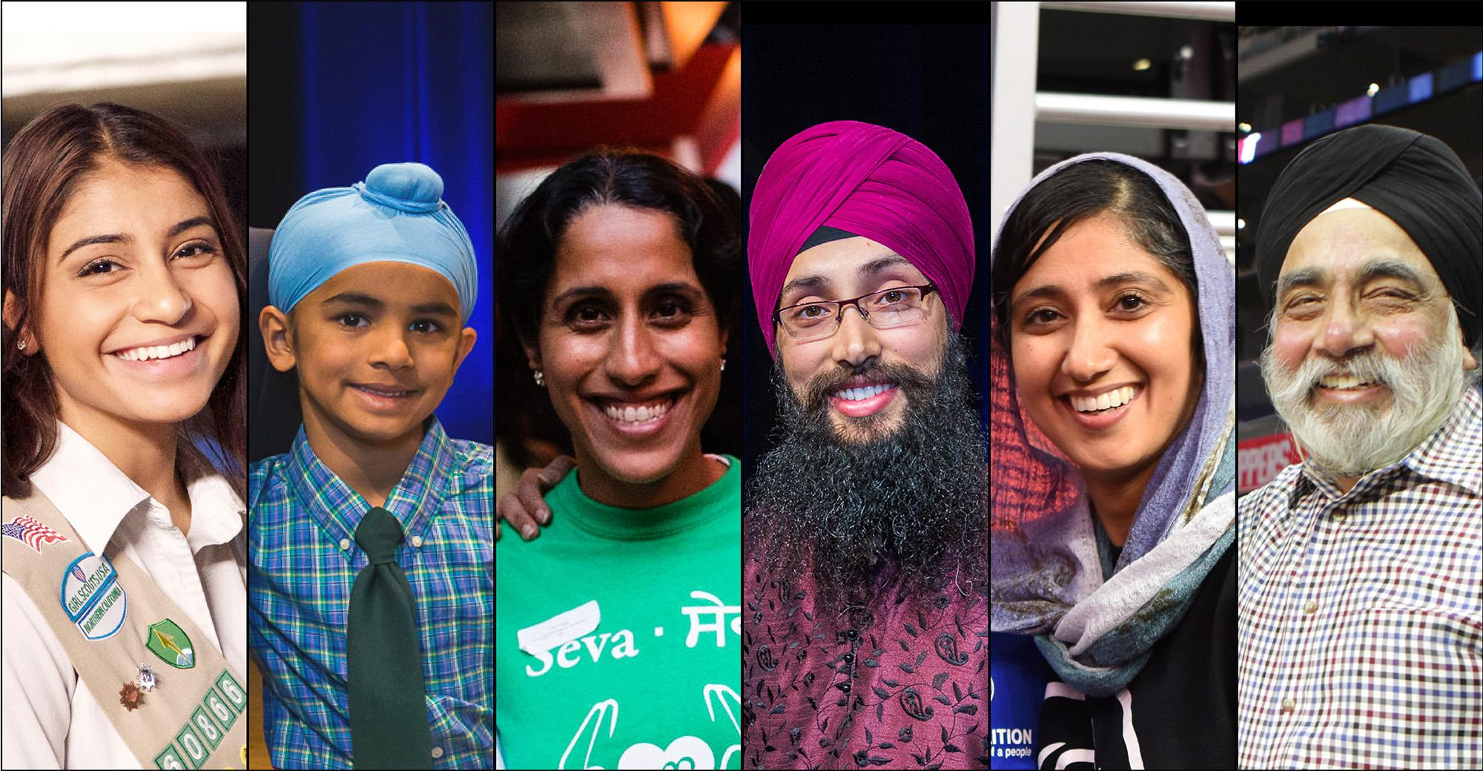
Have You Seen Them?
Notes:
If you’ve seen any of these people around school or around town, congratulations! You’ve just met a Sikh!

Slide 3
Sikhism: An Overview
Sikhism is the 5th largest religion in the world
Sikhism believes in One God
Sikhism started in India with the birth of the first Guru in 1469 AD, followed by 9 other living Gurus.
Today, the Guru is the holy book the Guru Granth Sahib

Slide 4
Core Beliefs
One God
Loves and Sustains all of Humanity
All are equal in the eyes of God:
Respect for all genders, religions, races, etc.
Earning an Honest Living:
Sikhs are supposed to work and live honestly
Share with Others:
Share your time, money, etc. with others
Remember God
Throughout one’s day
Sikhs do not believe in the following:
Fasting, superstitions, ritualism, caste system
Sikhism prohibits:
Smoking, drinking alcohol, or taking any intoxicants

Slide 5
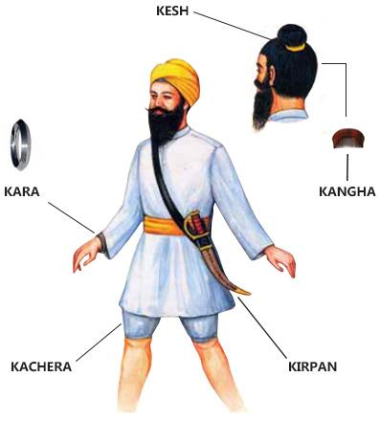
The 5 K’s

Slide 6
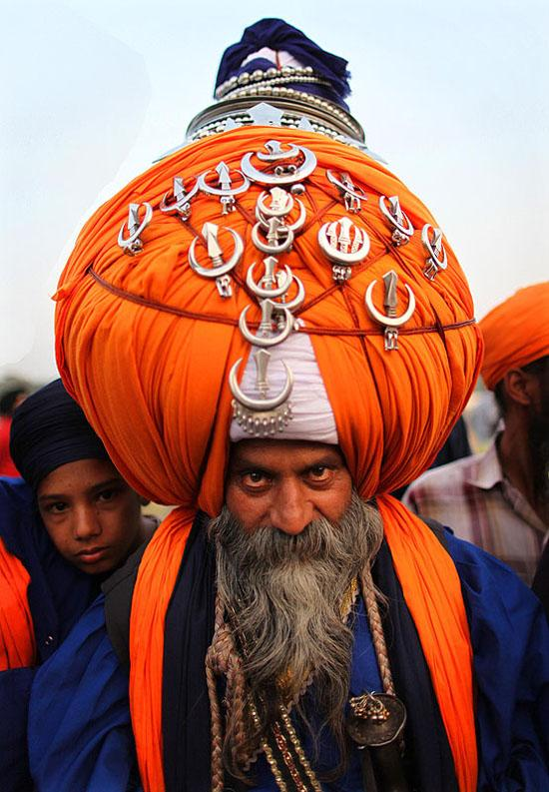
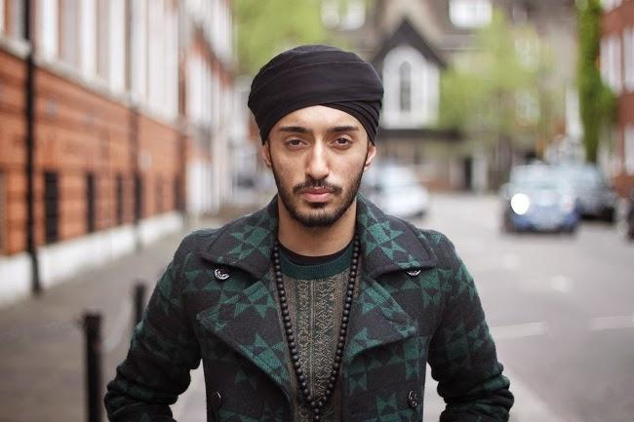
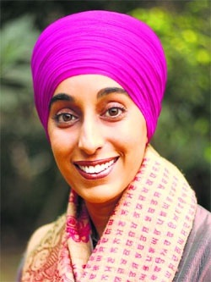
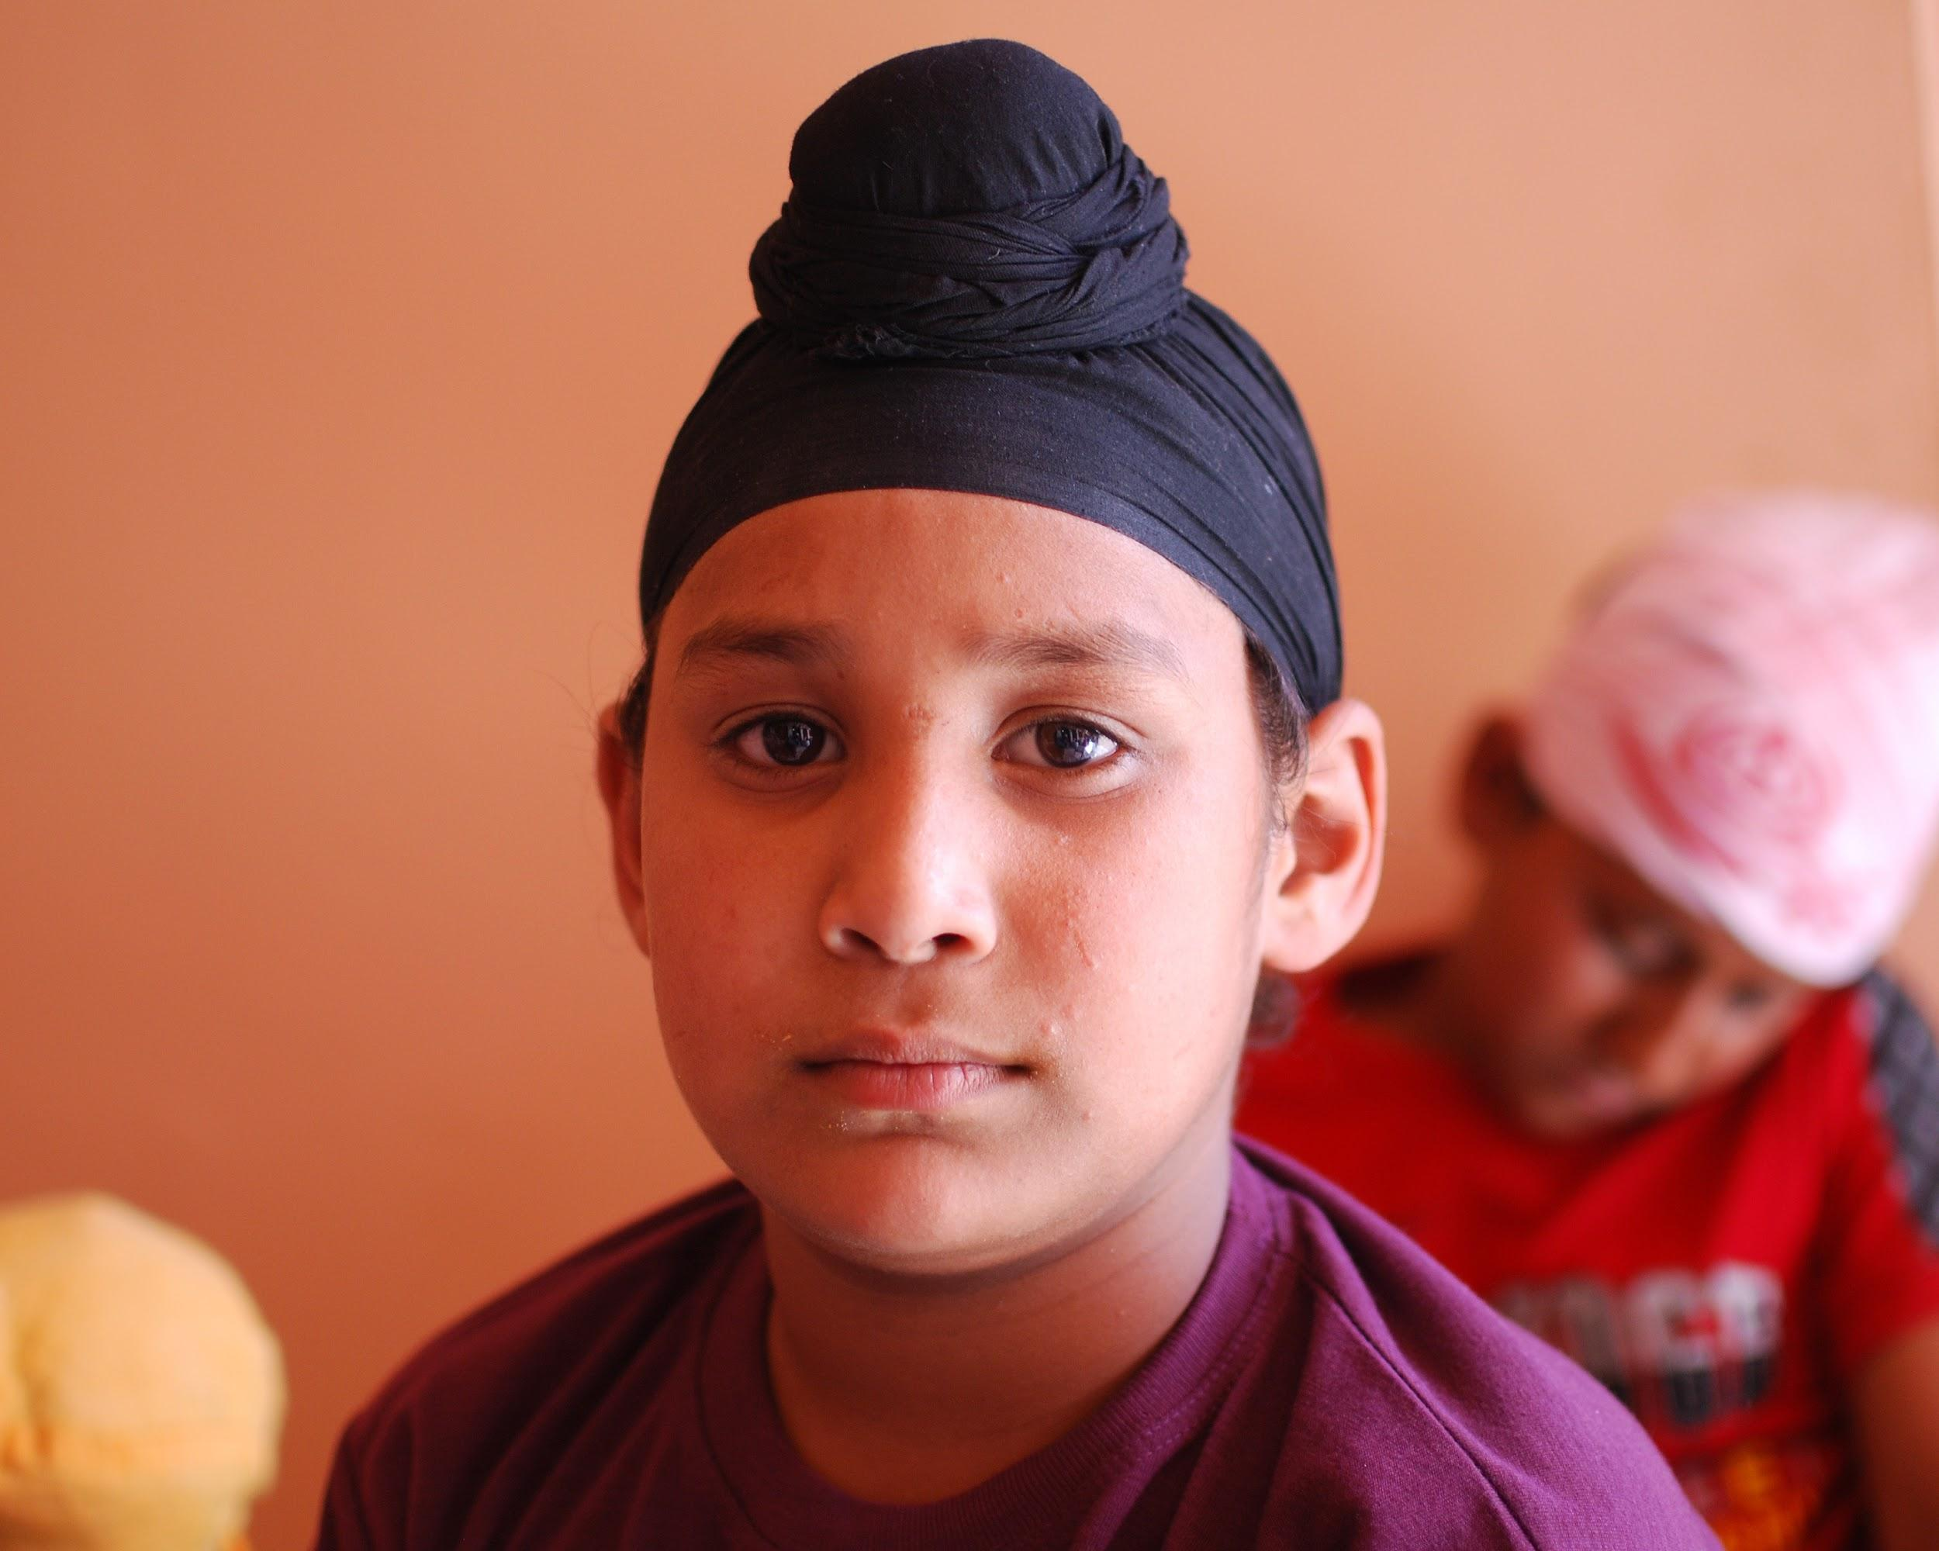
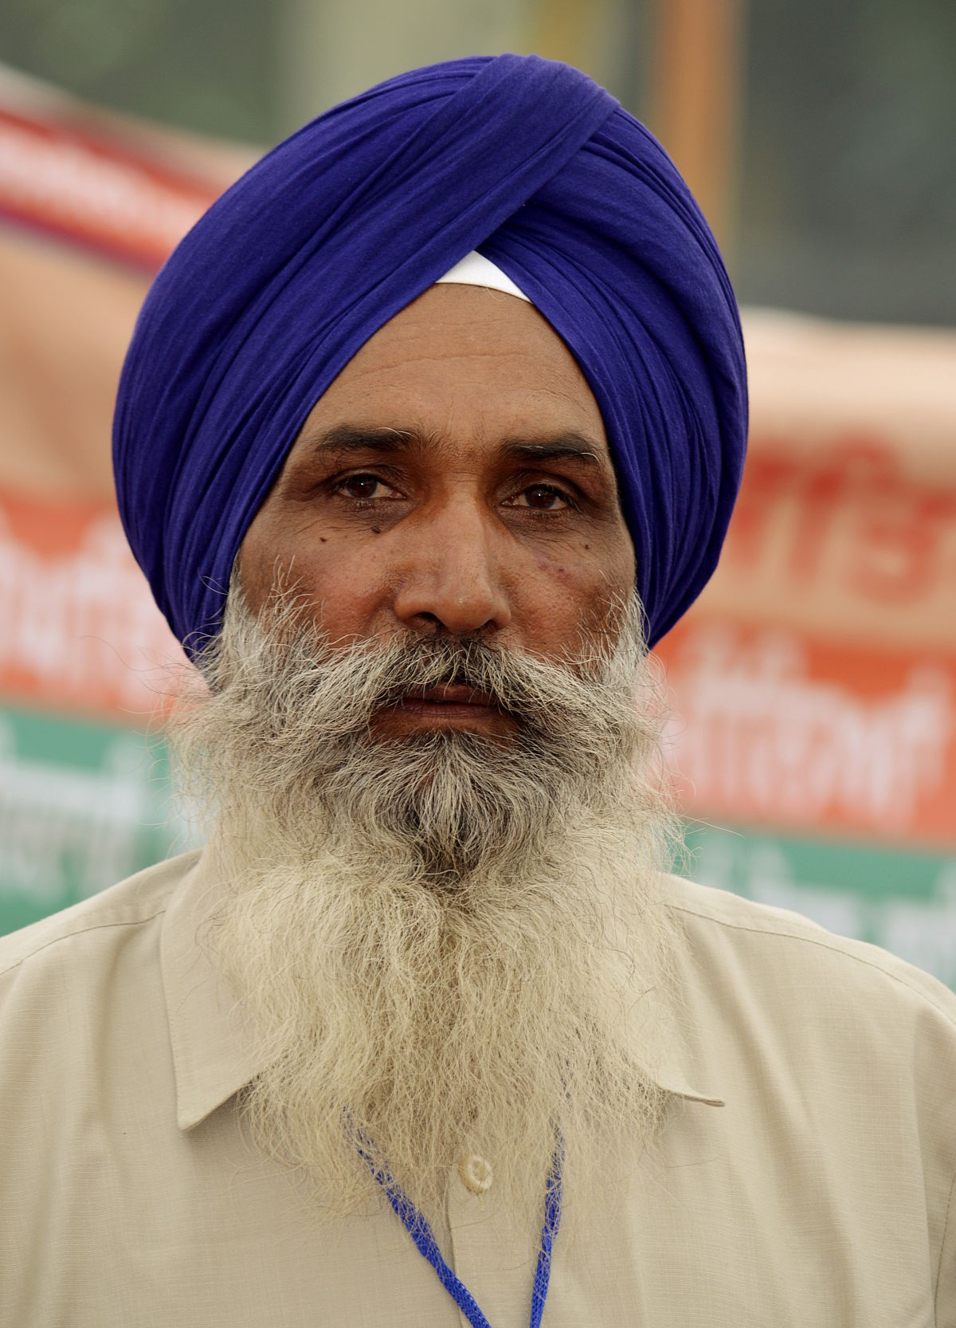
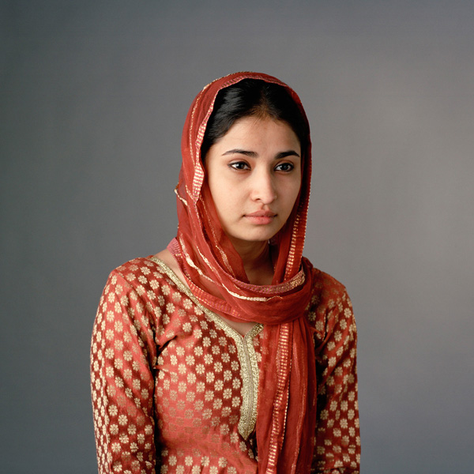
The Turban

Slide 7
A BRIEF HISTORY OF SIKHS IN INDIA

Slide 8
Early Modern (1469 CE – 1750 CE)
There were 10 living Gurus until 1708 CE, when the Guru Granth Sahib became the final Guru
Guru Nanak started the religion to combat the injustices he saw in society
Guru Angad Dev Ji created the Sikh script Gurmukhi
Guru Amar Das Ji started the tradition of Langar
Guru Ram Das Ji started the building of Amritsar and the Golden Temple
Guru Arjan Dev Ji was the first prophet executed for not submitting to the Mughal rulers and also compiled the first Holy Book, the Adi Granth
Sikhs were primarily a peaceful force until the sixth Guru Hargobind Ji who first started the Sikh military traditions
Guru Har Rai Ji lead environmental and medical reforms in Sikh society

Slide 9
Early Modern (1469 CE – 1750 CE)
Guru Har Krishan Ji was the youngest Guru at age 5 and devoted his life to healing those afflicted by the smallpox epidemic in India. He died of smallpox himself before reaching the age of 8.
Guru Tegh Bahadur Ji became a martyr after sacrificing himself to save a group of Brahmins from being forcibly converted to Islam by the Mughal ruler Aurangzeb.
Guru Gobind Singh Ji started the tradition of baptism in the Amrit ceremony, gave the last name Singh and Kaur to all male and female Sikhs respectively, and created the 5 K’s.
Bandha Singh Bahadur created the first Sikh Empire which ended with his martyrdom

Slide 10
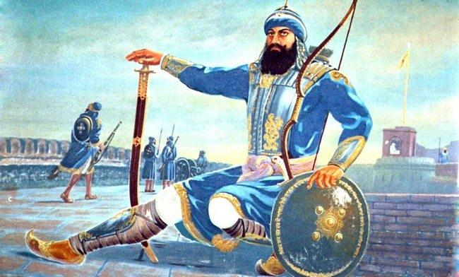
Notes:
Banda singh bahadur

Slide 11
Age of Revolution (1750 CE – 1914 CE)
The collapse of the first Sikh Empire lead to the creation of the Sikh Misls
The Misls used guerilla warfare tactics to attack Mughals
From time to time the Misls were united by various leaders to accomplish various common goals
There were times of tentative peace between the Sikhs and the Mughal Governments in Punjab and Dehli
Sikhs also faced the Wadda Ghalughara (The Great Massacre), as well as the destruction of the Golden Temple many times
The Misls were all reunited once again by Sada Kaur and Ranjit Singh, creating the second Sikh Empire under Maharaja Ranjit Singh
The Sikh Empire was the last remaining stronghold against the British Empire in India
Sikhs became a key force in the British-Indian Army and were believed to be a martial race by the British
Notes:
Various leaders: Nawab Kapur Singh, Jassa Singh Ahluwhalia, Jassa Singh Ramgarhia

Slide 12
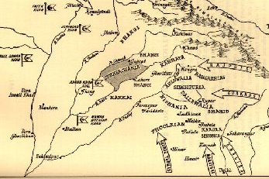
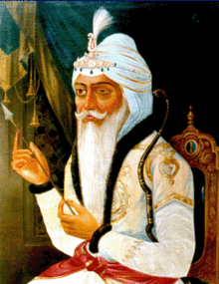
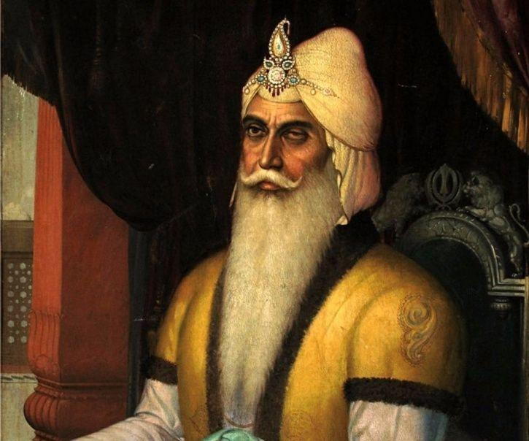

Slide 13
Contemporary period (1914 – present)
Sikhs had slowly started moving out of India and emigrating to Canada, Britain, and the American west coast (mostly California)
In World War 1 Sikhs consisted of around 22% of the British Armed Forces, yet the Sikhs only made up less than 2% of the total population in India, Sikhs also served in World War 2 in the British, Canadian, and American armies. It is estimated around 80,000 Sikhs died in World Wars
Sikhs clashed a lot with the British such as in the Jallianwala Bagh massacre and the formation of the Gadhar party for independence
The 1960s saw heavy civilian casualties in Punjab with the partition of India and saw growing animosity and rioting between Punjabi Sikhs and Hindus in India, as the Punjabi Sikhs agitated for the creation of a Punjabi Sikh majority state
In 1984 tensions fueled by Sikh claims of discrimination and marginalisation boiled over and led to Indira Gandhi declaring emergency rule and instituting a curfew in Punjab, then attacking the Golden Temple in Operation Blue Star using the Indian Army.

Slide 14
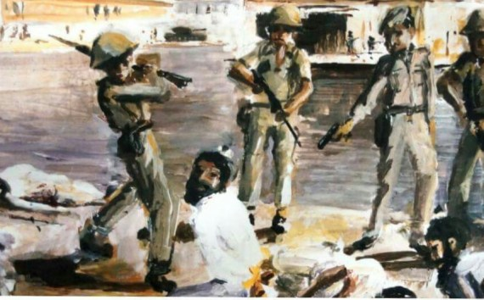
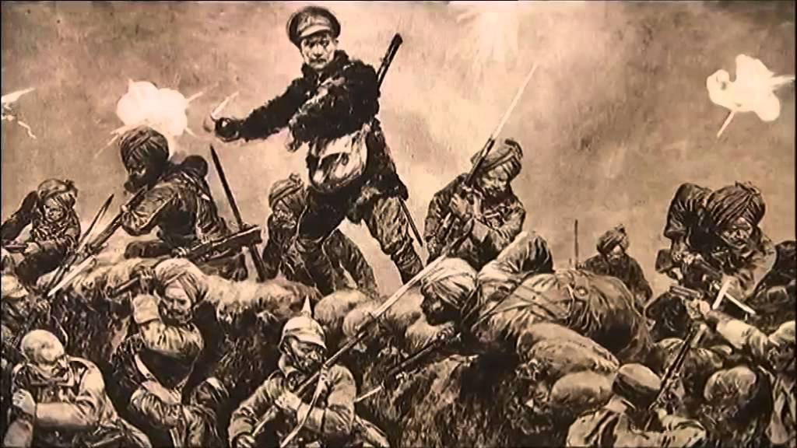
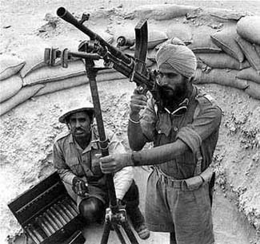
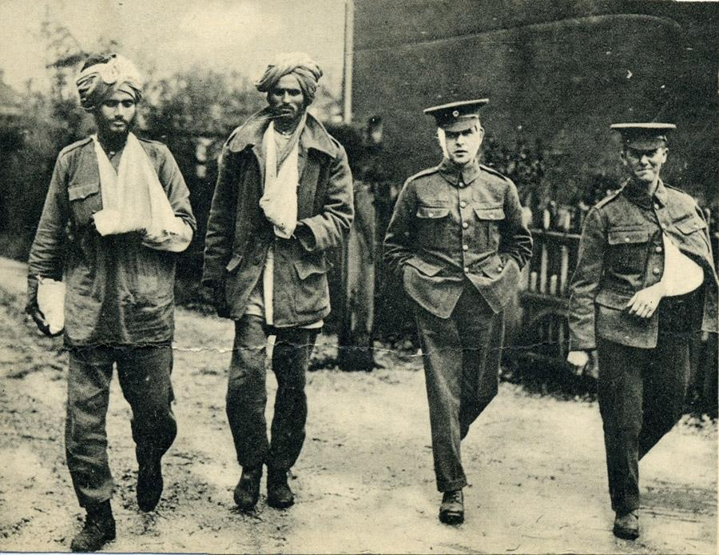
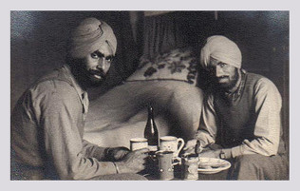
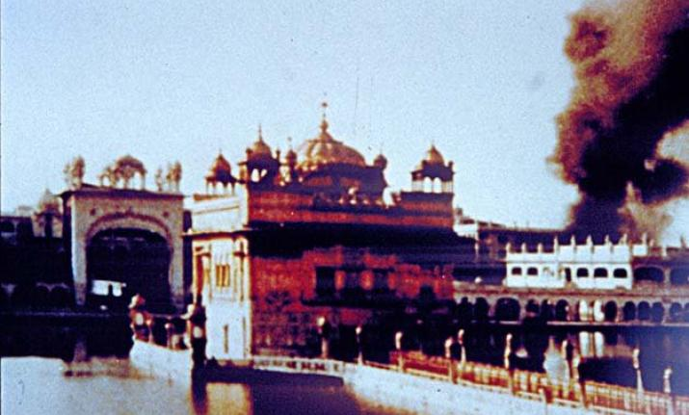
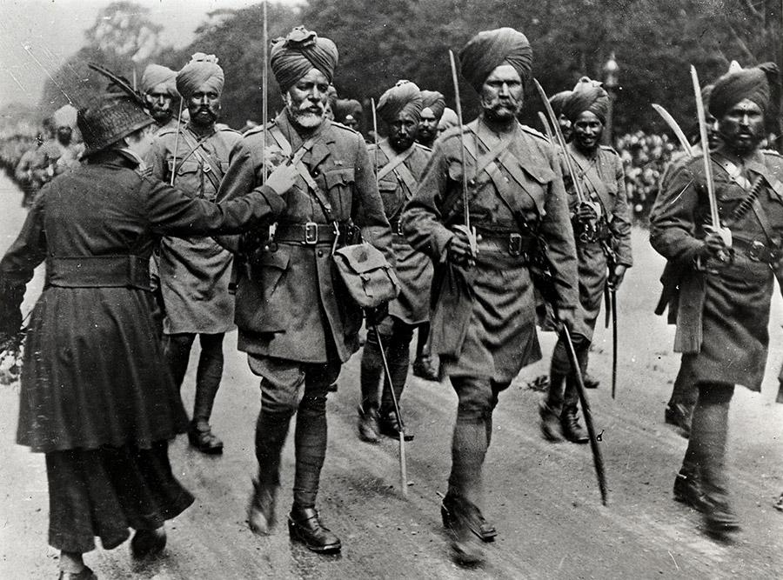

Slide 15
Sikhs in North America
Canada has the highest Sikh population outside of India
The first Sikhs came to the United States in the 1890s to work in the lumber mills of the Pacific Northwest, in the farms of California, and to build the railroads that would connect America.
Despite violence designed to keep them from making the U.S. their home, in 1912, the first gurdwara was established in Stockton, California
Sikh American pioneers tried to help their country fulfill its promise of equality and opportunity for all who call it home. In 1923, Bhagat Singh Thind, a World War I veteran, went to the Supreme Court to challenge laws that prevented Asians from becoming citizens. Following in his footsteps as a Sikh American pioneer, in 1957, Dalip Singh Saund became the first Asian Pacific American and first Sikh American to serve in the US Congress.

Slide 16
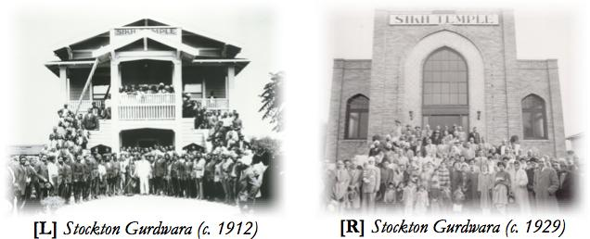
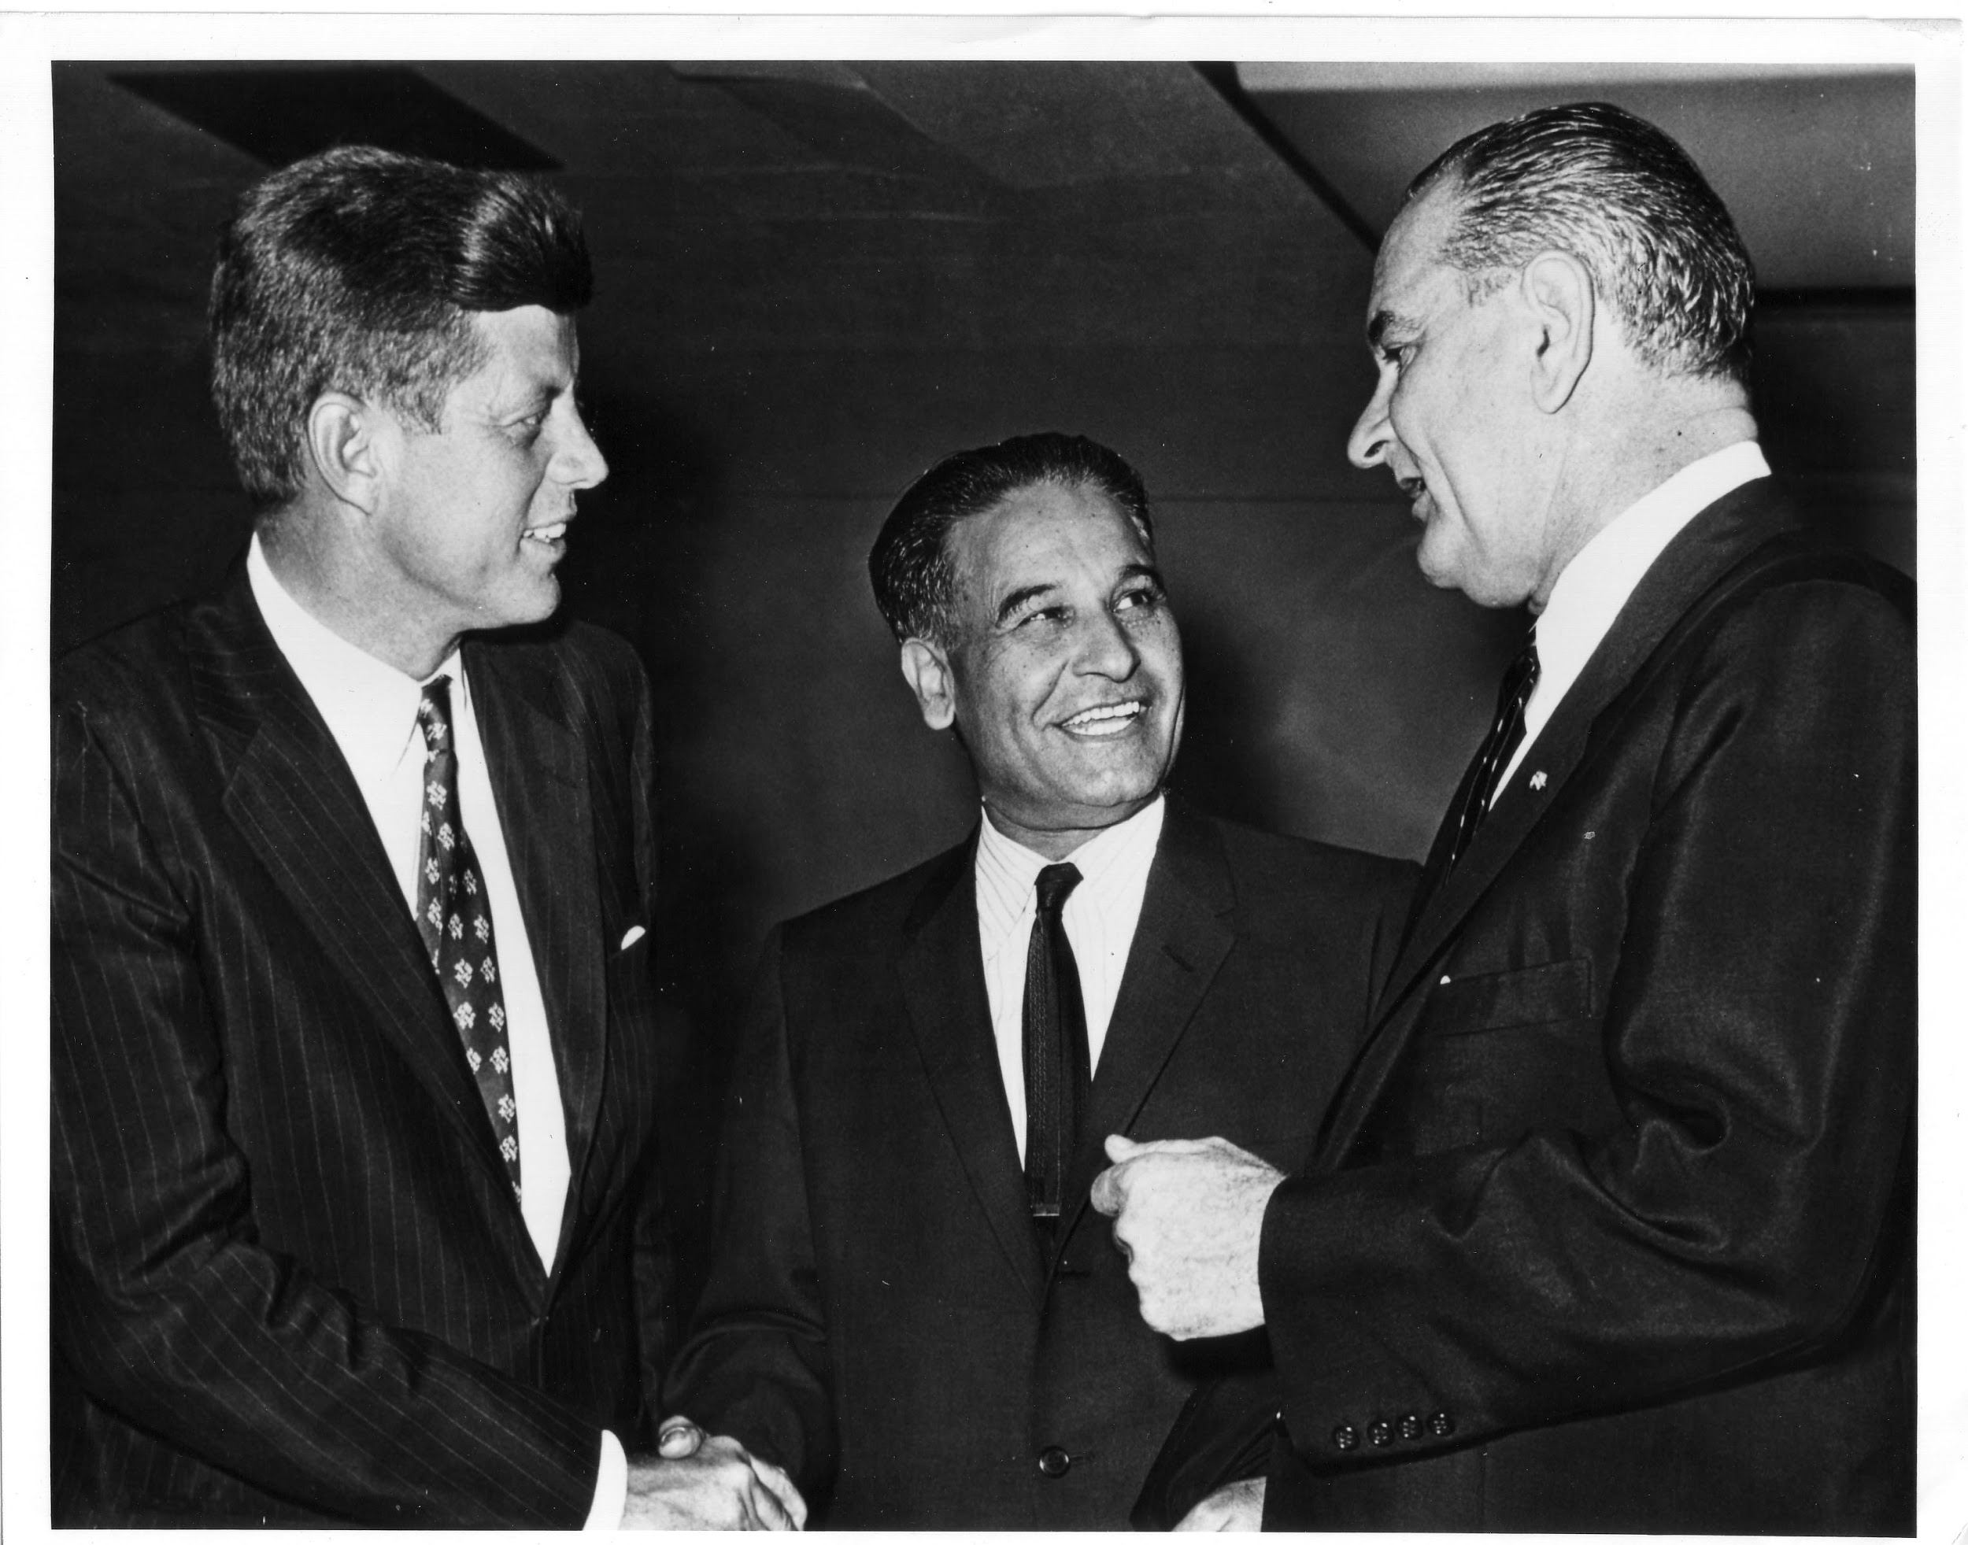
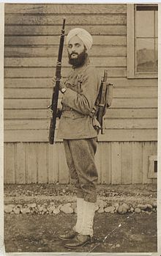
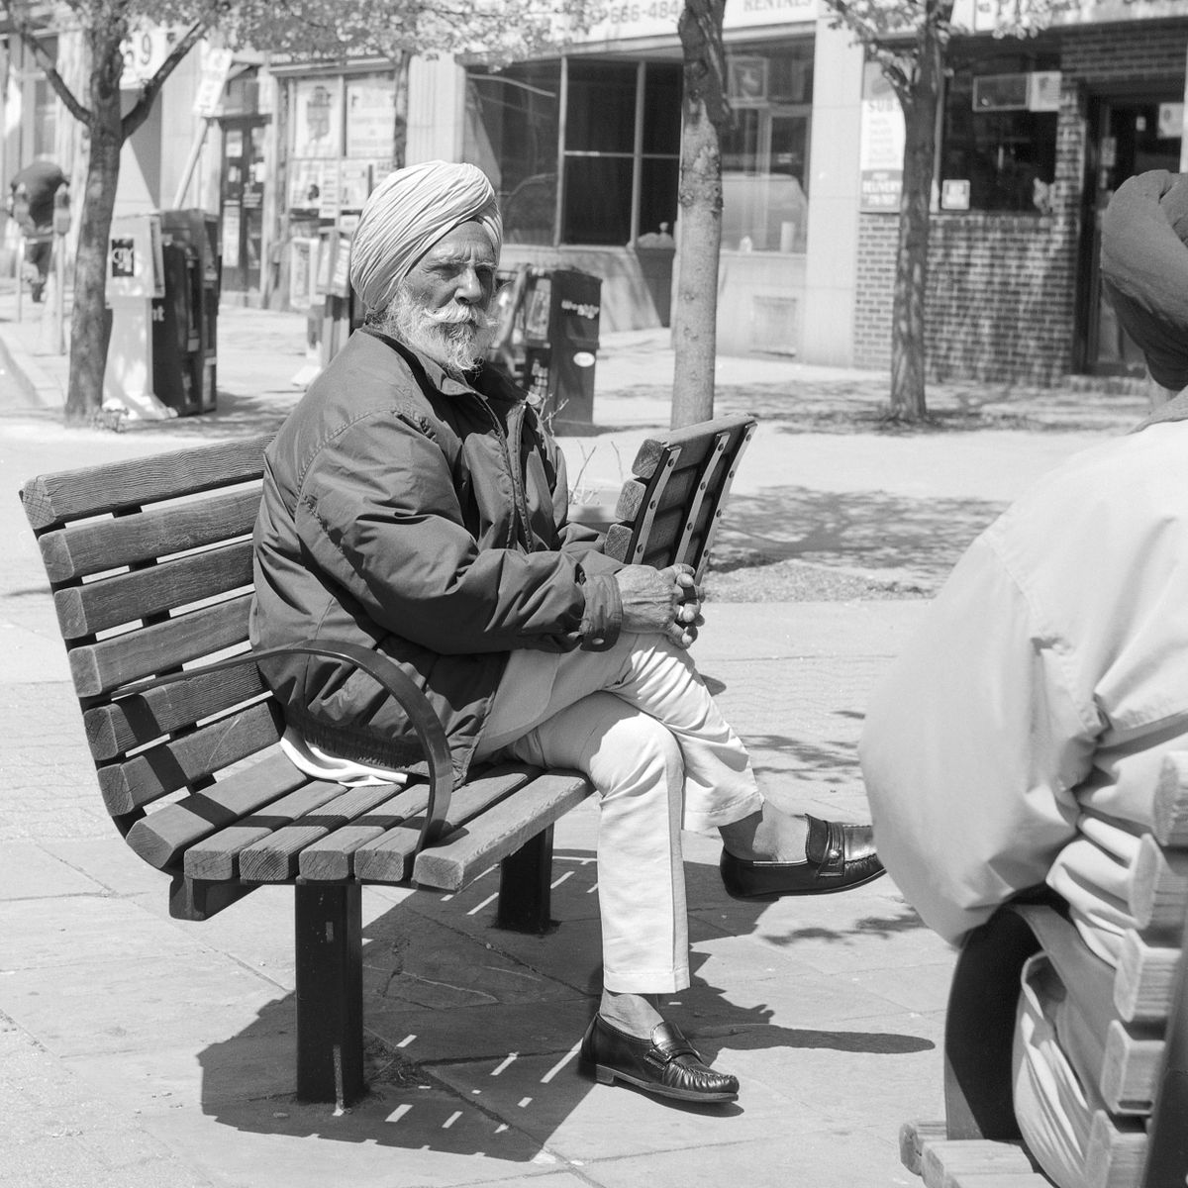
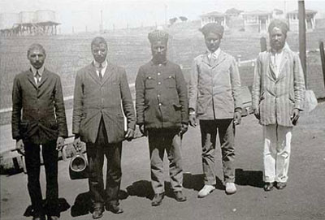
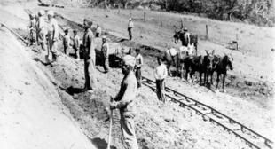

Slide 17
Famous Sikhs

Slide 18
Bhagat Singh Thind
Lead the charge for Asian-American immigrants who fought in the US Army to be eligible for citizenship

Slide 19
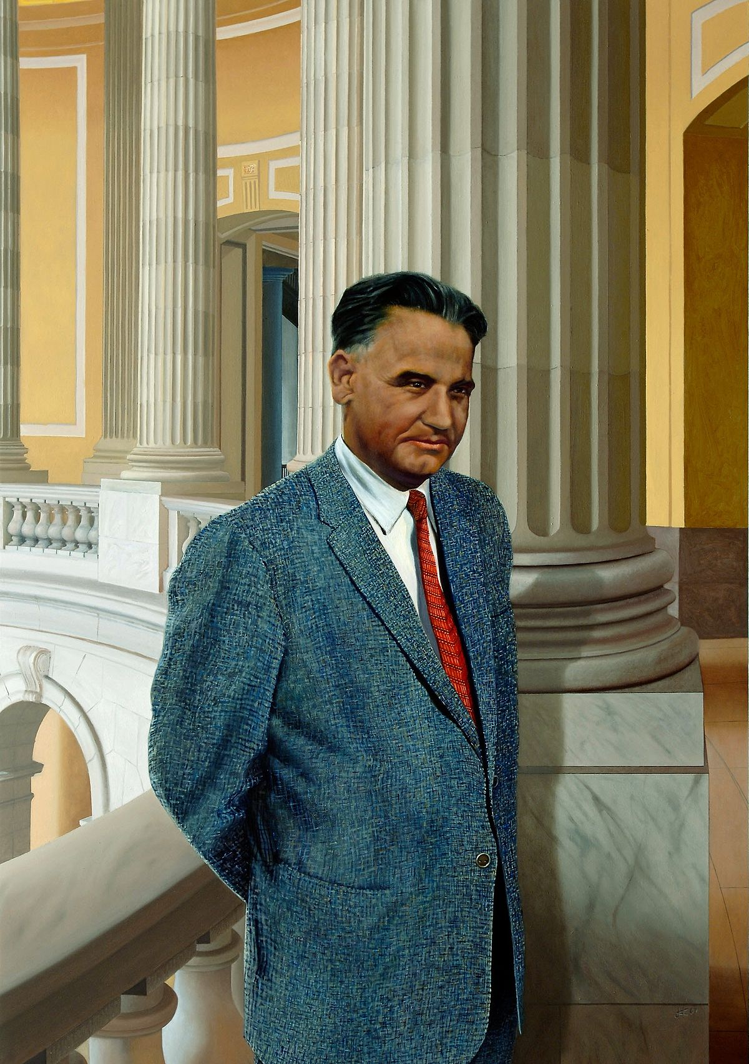
Daleep Singh Saund
First Asian-American and Sikh-American Congressman

Slide 20
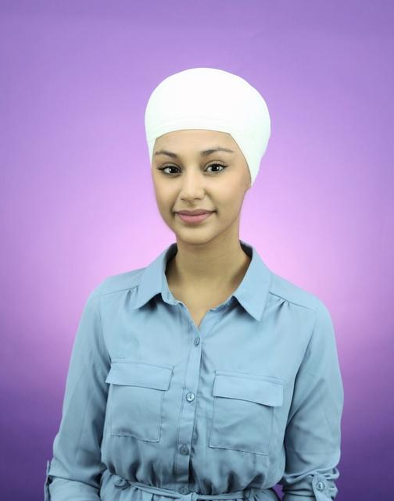
Harman Kaur
Famous poet and Sikh rights activist

Slide 21
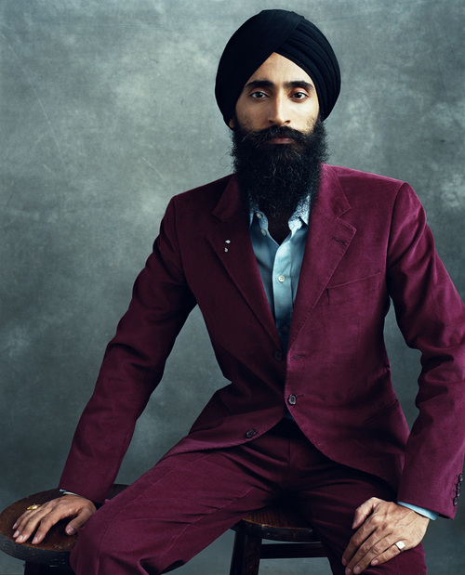
Waris Ahluwhalia
Famous actor and fashion designer who starred in a short film about Bhagat Singh Thind

Slide 22
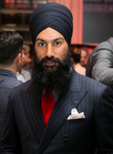
Jagmeet Singh
Leader of the Canadian NDP

Slide 23
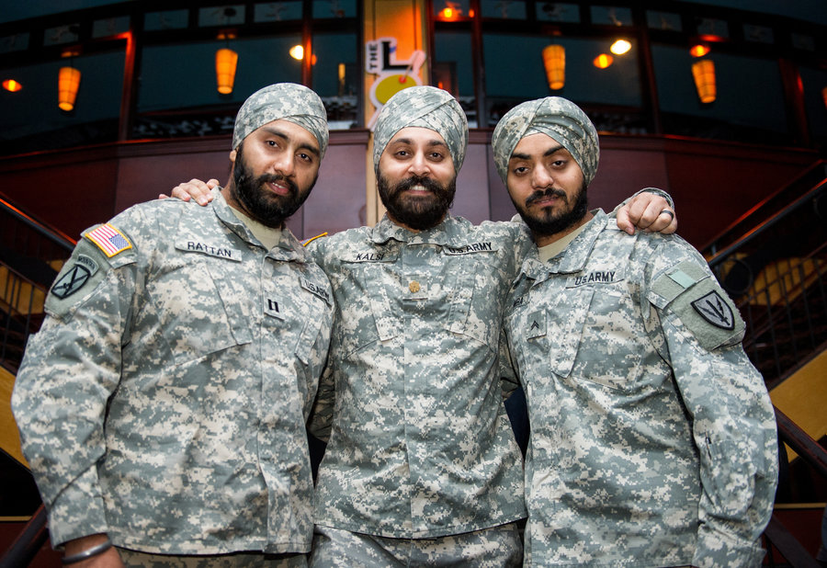
Capt. Tajdeep Rattan, Maj. Kamaljeet Kalsi and Cpl. Simranpreet Lamba
First Sikhs to serve in a non-combat position while keeping their turban and unshorn hair

Slide 24
Rupi Kaur
Author of the best selling poetry book Milk and Honey

Slide 25
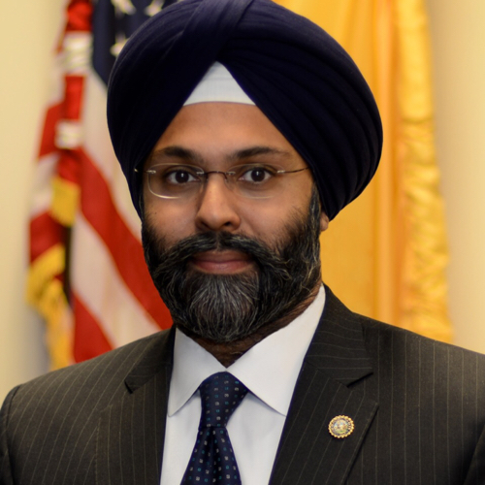
Gurbir Singh Grewal
First Sikh State Attorney General in America

Slide 26
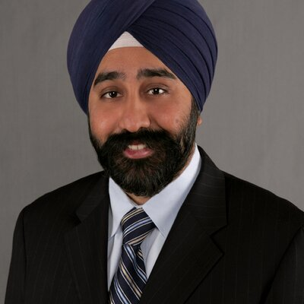
Ravi Bhalla
First Sikh Mayor of New Jersey

Slide 27
How to visit a Gurdwara
Be modestly attired.
Cover your head.
Remove your shoes.
Wash hands, and feet if needed.
Bow respectfully before the Guru Granth Sahib.
Offer any donation such as flowers, food items, or money.

Slide 28
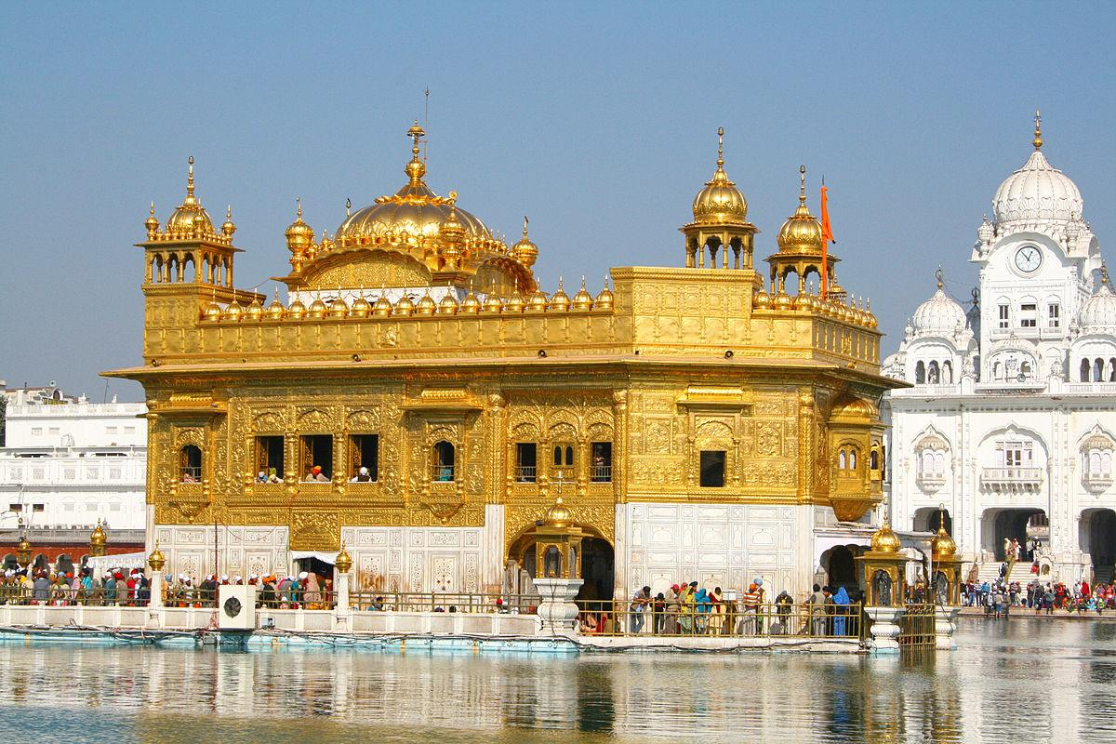
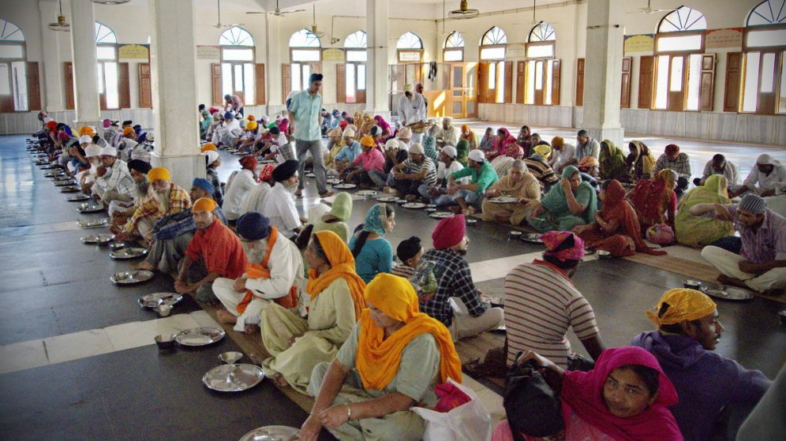
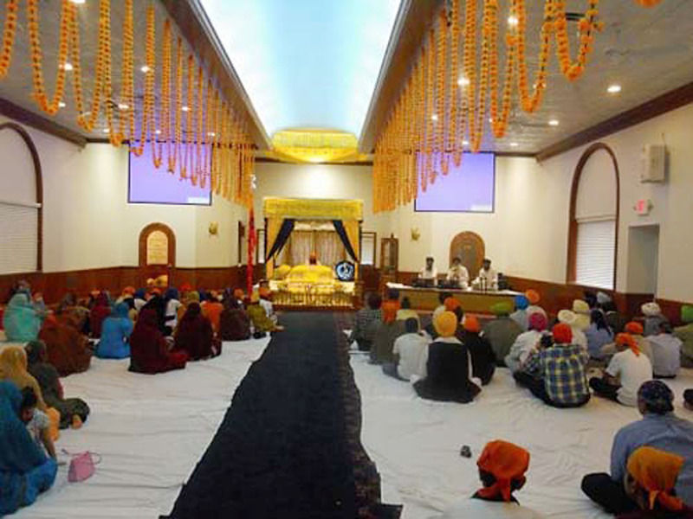

Slide 29
“Who We Are”
https://www.youtube.com/watch?v=vXErPzsqRu8

