Slide 1

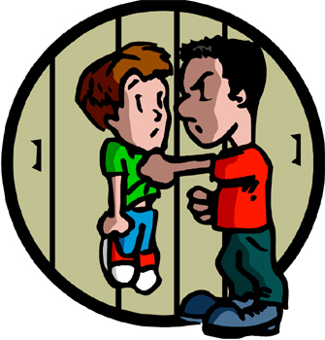
School Bullying

Slide 2

Table of Contents
What is bullying?
Who are Sikhs?
Why are Sikh students bullied?
What to do if you are bullied?
If you see someone being bullied
You might be bullying if…

Slide 3

What is Bullying?
Bullying is when someone tries to hurt or attack someone else by…
  Making them feel uncomfortable

Slide 4
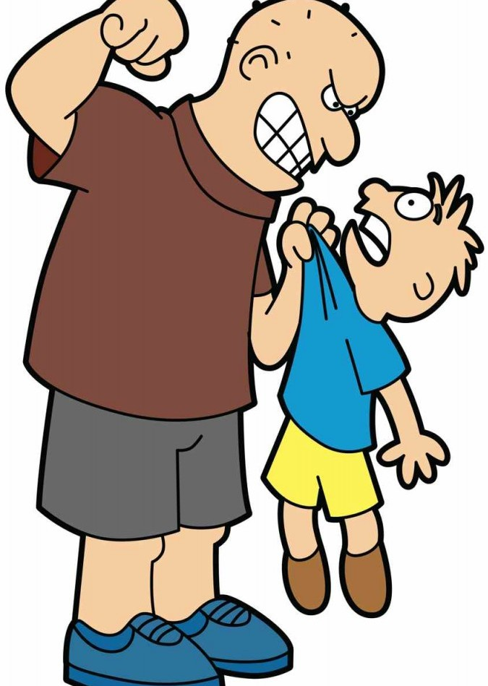
What is Bullying?
  Hurting them by kicking, hitting, pushing, tripping etc…

Slide 5
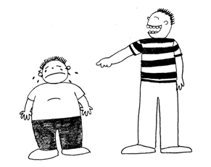
What is Bullying?
Name calling and spreading nasty rumors.

Slide 6
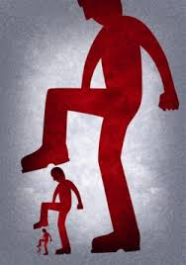
What is Bullying?
Hurting the other person over and over.

Slide 7
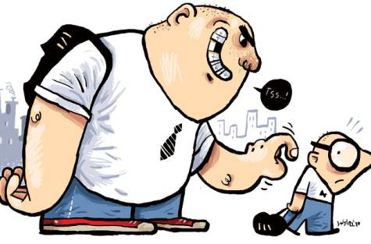
Who Do Bullies Pick On?
Kids they feel are smaller
Kids they think won’t stand up for themselves
Kids that have few friends

Slide 8
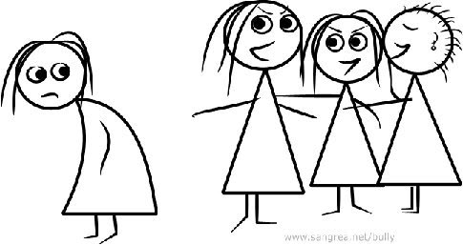
Why Do Students Bully?
Sometimes...
To impress their friends
To enjoy feeling power
They don’t even realize they are hurting someone

Slide 9
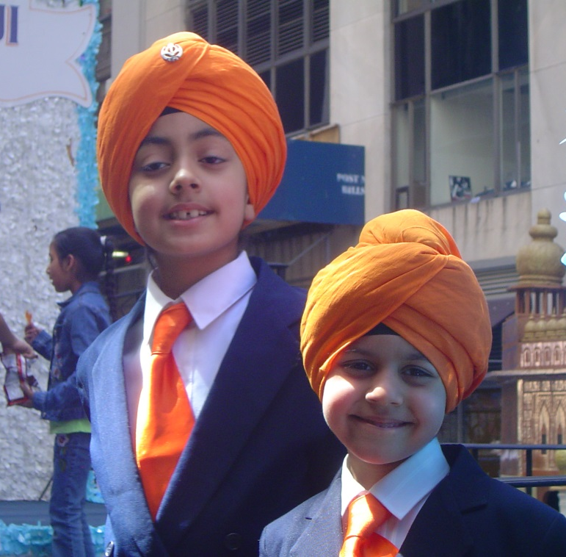
Who are Sikhs?
It is the 5th largest in the world.
Sikhism is a 550-year-old religion that began in the subcontinent of India.
Sikh means student.
Sikhs are students of the Guru (teacher).
Notes:
Sikhism is a 550 year old religion that began in subcontinent of India
It is now the 5th largest religion in the world
All Sikhs must wear 5 Articles of Faith (called Kakaars) and keep their heads covered at all times
Sikhs are students and follow the Guru(teacher); that brings them from dark to light
Founded in 1469 – Birth of Guru Nanak Dev Ji and built upon by next 9 Gurus
The Guru Granth Sahib (Sikh scripture) is the living Guru of Sikhs
Nitnem (daily prayers)
Amritdhari (Initiated) Lifestyle
Don’t cut your hair
No consumption of intoxicants
No adultery
No consumption of Halal meat
Must wear 5Ks at all times
Distinct from Hinduism and Islam
Sharing One’s Earnings With Others (Vand ke Chakna)
All are Equal (applies to gender, creed, color, etc.) –Caste system is condemned
Belief in Freedom of Thought & Expression
Do not believe in caste, idols, or superstitions
Male Sikhs have a common last name “Singh” and Female Sikhs, “Kaur”

Slide 10
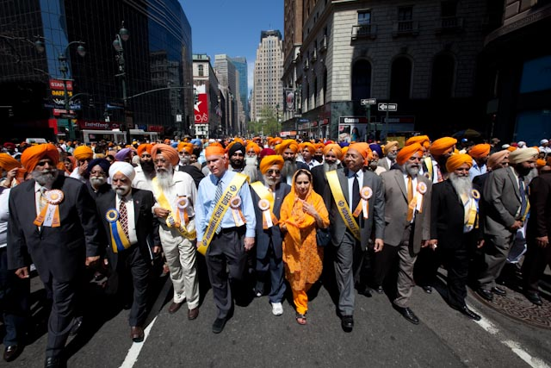
Facts on Sikhism
In United States, 99% of people that wear turbans are Sikhs.

Slide 11
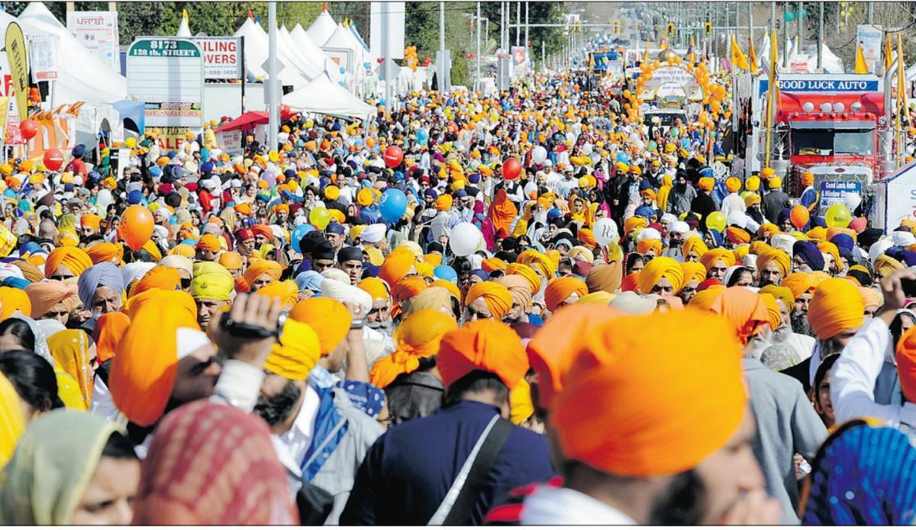
Facts on Sikhism
Sikhism is not a branch of Hinduism or Islam.
Sikhism rejects the caste system and Sikhs believe in the absolute equality of all mankind.

Slide 12
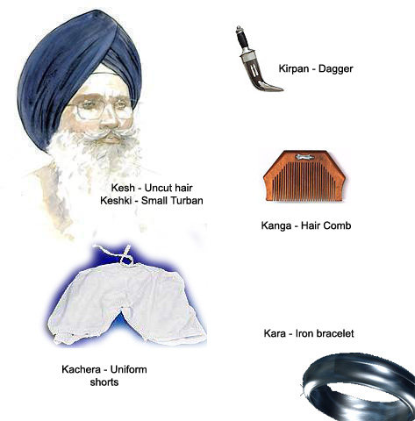
Articles of Faith
  Five Articles of Faith (Panj Kakaars) also called the…
  5 K’s: Kesh, Kanga, Kara, Kirpan, Kachera

Slide 13
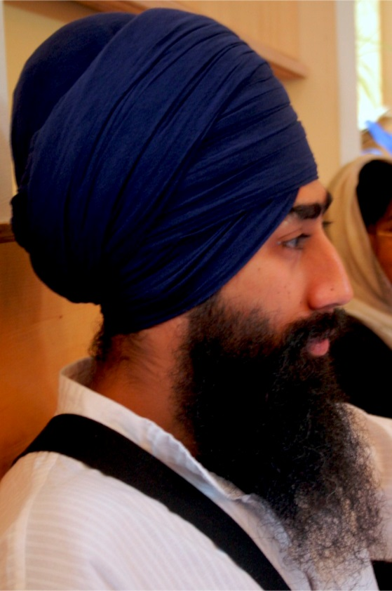
Kesh–Unshorn Hair Covered By A Turban
It is the most recognizable feature of a Sikh
The turban (dastaar) is worn by a Sikh at all times, to cover the kesh (unshorn hair)
Sikhs wear it as a mark of commitment to their faith
Notes:
It is the most recognizable feature of a Sikh.
The turban (dastaar) is an integral part of the Sikh identity and is worn by a Sikh at all times, to cover the kesh (unshorn hair).
Sikhs wear it as a mark of commitment to their faith.

Slide 14

Kanga-Wooden Comb
Small comb that Sikhs wear in their hair
Notes:
The “Kanga” represents the importance of discipline and cleanliness according to a Sikh way of life

Slide 15
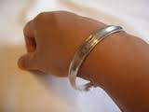

Kara-Steel Band
A steel band worn on the wrist
Notes:
A steel band worn on the wrist to remind Sikhs that they are bound to the Guru’s teachings

Slide 16
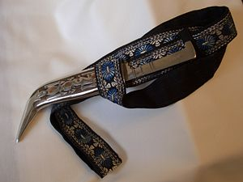
Kirpan-Ceremonial Knife
Reminds of the duty to stand up for human rights and justice
Notes:
The ‘Kirpan’ is the tangible expression of a Sikhs sacrifice of oneself in order to defend the truth.
It reminds Sikhs of their duty to defend and protect the weak and oppressed.

Slide 17

Kachera-Undershorts
Cotton undershorts
Worn at all times
Notes:
These are cotton undershorts worn by Sikhs as one of the articles of faith.
These must be worn at all times and is linked to a high moral character.

Slide 18
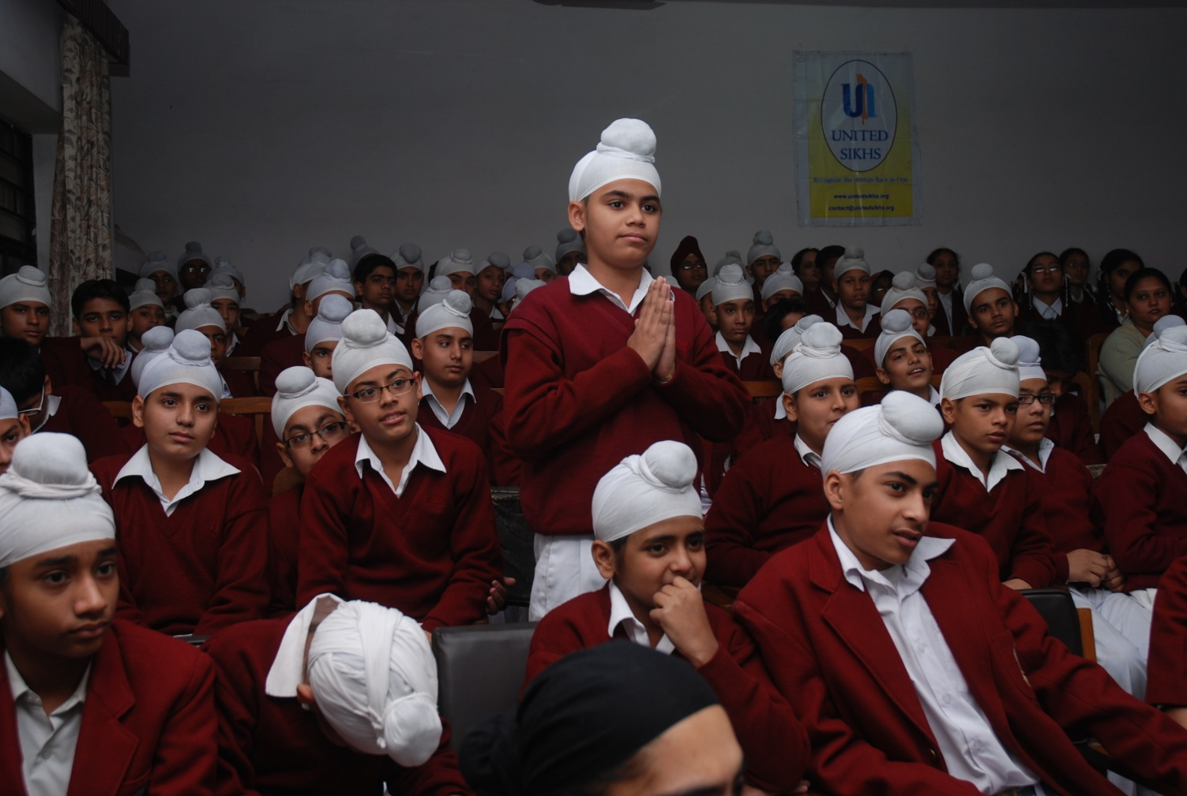
Identifying Sikh Children
Notes:
Patka- Smaller turban covering the hair tied in a knot- Here the presenter should talk about how most children tie patkas and not bigger turbans

Slide 19
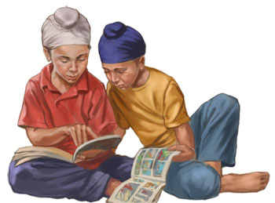

Why Are Sikh Students Bullied?
Look different

Slide 20

Why Are Sikh Students Bullied?
Different culture

Slide 21

Examples of Sikh Students Bullied
Patka set on fire in a High School in NJ
-A patka is a small turban worn by Sikh Students
Notes:
On Monday, May 5, 2008, Hightstown High School in New Jersey held a fire drill and all students were instructed to gather on the school playground. A Sikh student was chatting to his friends when a student he did not know came up behind him and set fire to his patka (turban) using a lighter.
The Sikh student "felt something hot" on his head and immediately patted his patka to put out the flames. Disaster was averted, but a great deal of emotional damage had already been done.

Slide 22
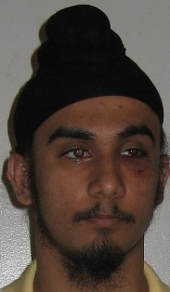
Examples of Sikh Students Bullied
A Sikh student punched with a key at a High School in Richmond Hill, Queens, NY
Notes:
Also in June 2008, Jagmohan Singh Premi, a student at Richmond Hill High School in Queens, NY, was punched in the face by a fellow student who tried to remove Jagmohan’s patka from his head. Jagmohan had been bullied by this student for quite a while, and this time, after partially removing his patka, the student punched Jagmohan in the face with a key pressed between his knuckles.

Slide 23
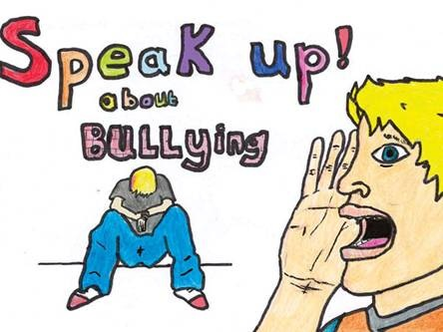
What To Do If You Are Bullied?
Never keep it a secret

Slide 24
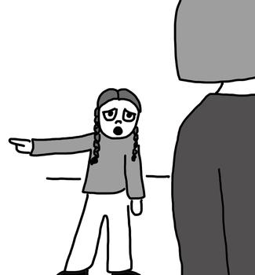
What To Do If You Are Bullied?
Talk to someone you trust
If that person can’t help, go to someone else

Slide 25
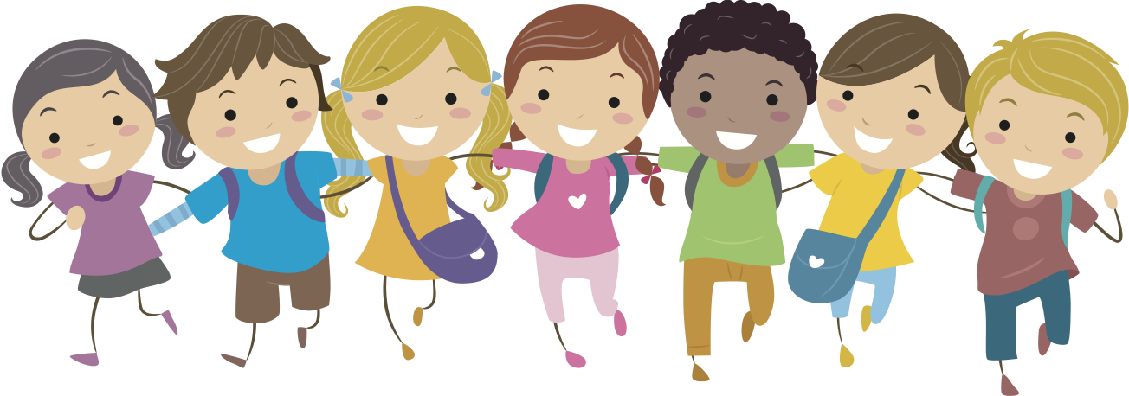
What To Do If You Are Bullied?
Try to surround yourself with friends
Try not to let the bully see that you are upset

Slide 26

What To Do If You Are Bullied?
Be confident in yourself
Bullies don’t like people who are not afraid

Slide 27

If You See Someone Being Bullied
Try to stop it
Help the person being bullied and tell an adult

Slide 28
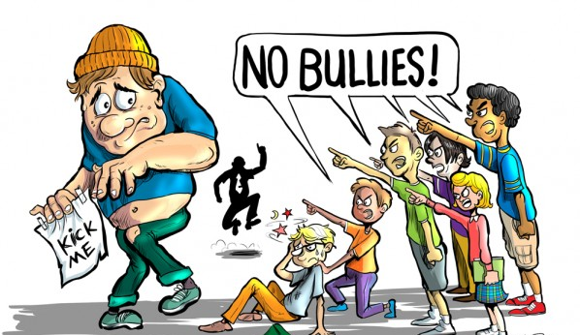
If You See Someone Being Bullied
If you do nothing, you're saying that bullying is okay with you.
It is best to treat others the way you would like to be treated.

Slide 29
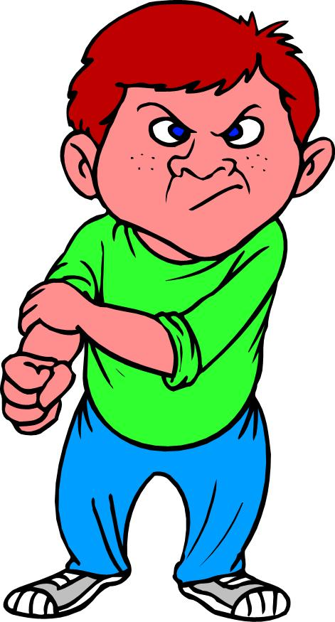
You might be bullying if…
Is there a kid that you make jokes about?
Have you ever made fun of someone?
Have you ever joined in making jokes about someone, either in person or online?

Slide 30

If You Are Bullying…
Think about why you do it and how you were feeling at the time
Remember, it's best to treat others the way you would like to be treated.
Speak to School Counselor(s), Teacher(s), Principal, or a Parent about it

Slide 31
Additional Resources
Department of Health and Human Services: http://stopbullyingnow.hrsa.gov/adults/catalog-of-resources.aspx
Anti Defamation League: http://www.adl.org/education/no_bullying.asp
Cyber-Bullying Research Center: http://www.cyberbullying.us/
Department of Education: http://www.findyouthinfo.gov/

Slide 32


Slide 33


WE CAN END BULLYING BY WORKING TOGETHER
JAF, POB 7203
New York, NY 10116, USA
718-441-6644

